Slide 2
“CLI First” Development
Corey Butler
Managing Director, Ecor Ventures Cofounder, Author.io, Metadoc.io

Slide 3
What Is CLI First?
The CLI First strategy is a thought framework
for managing development projects.
…and yes, building a CLI tool

Slide 4
Stages
Traditional
Simplified
Plan
Prove
Develop
Pivot
Maintain
Code at every stage!

Slide 5


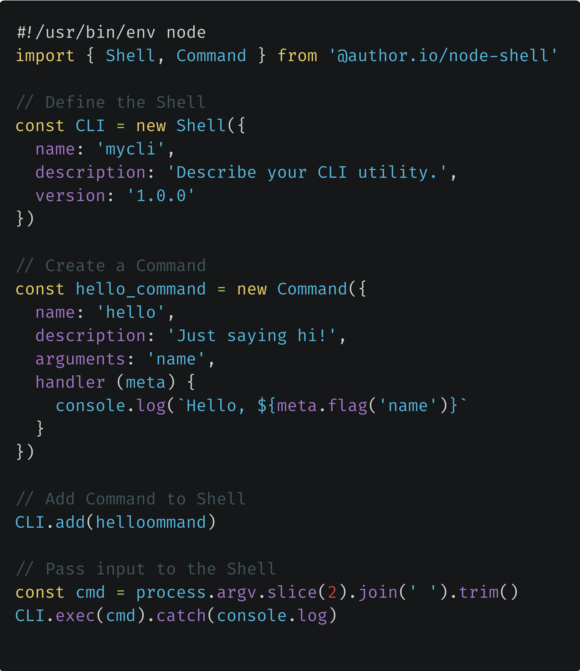
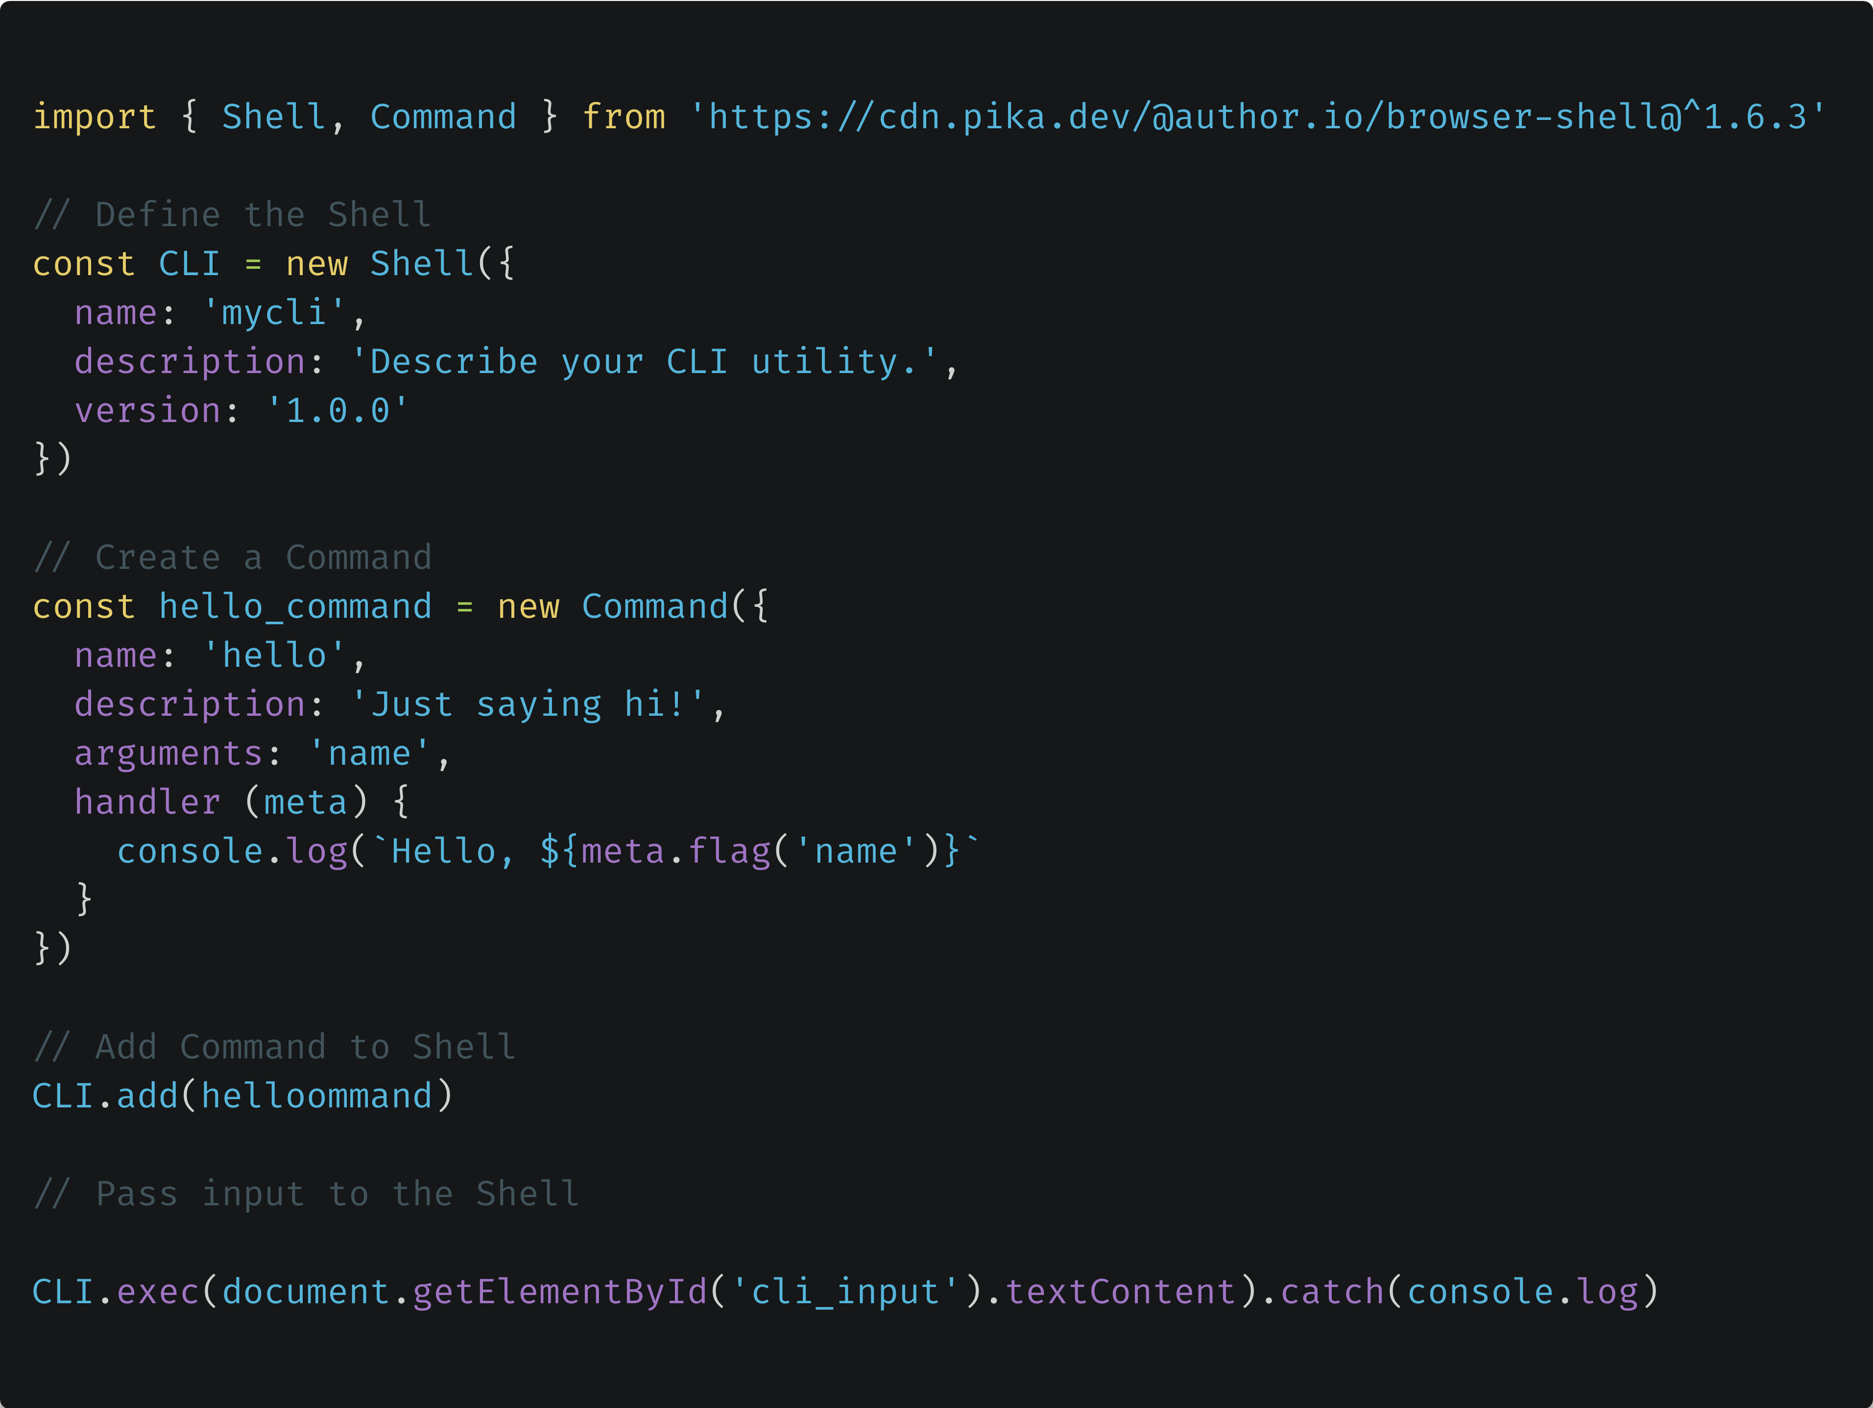
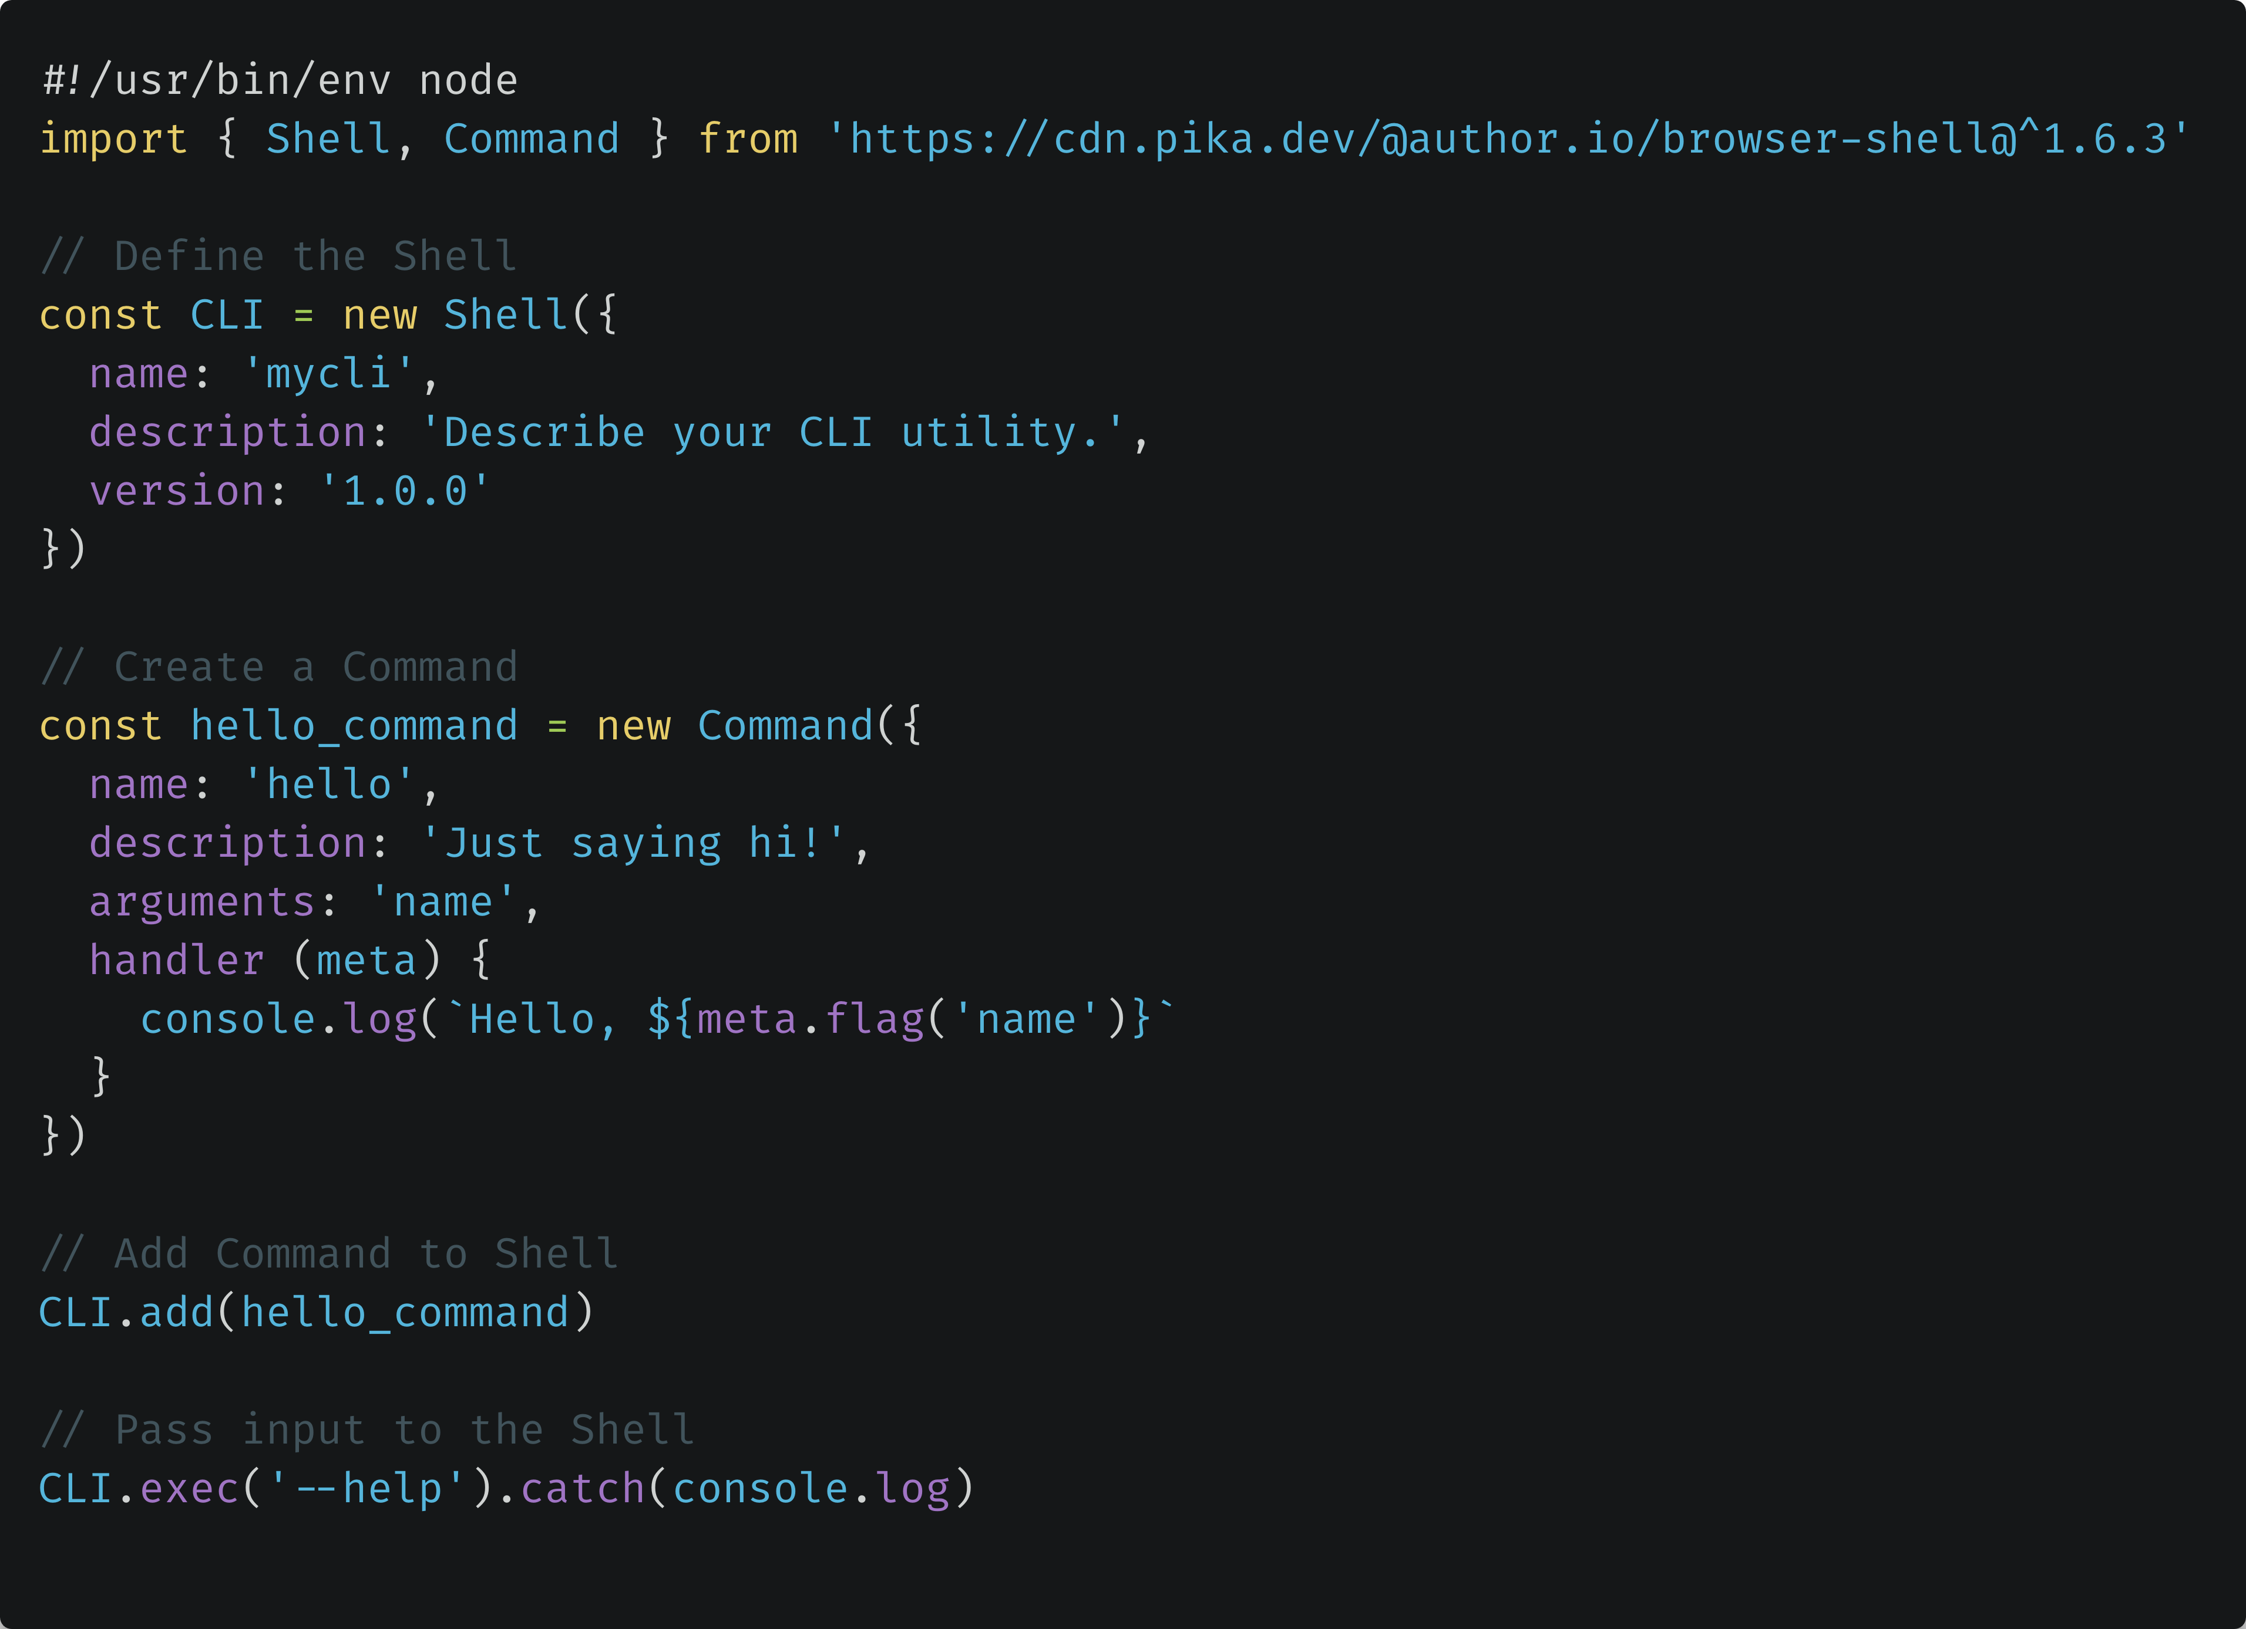
Shell Library
github.com/author/shell
Cross-runtime. Lightweight.

Slide 6

CLI Devtools Extension
“CLI” in Chrome Web Store
This:
Instead of this:
CLI.exec(‘account create')

Slide 7
Planning Recap
Simplified
Aligned
Tangible Baseline
team [COMMAND]
Team: A Group Communication Platform
Commands:
user Login and access account details.
directory Interact with the directory feature.
wall Interact with the discussion feature.
notification Send notifications.
“Let’s add group subcommands for notifications.”
“Think you can make an authentication request work?
You don’t need to worry about the UI, just the API.”
”Sure, I can make user authentication work.”
Get to “yes” faster.

Slide 8
Prototyping Recap
Inherits progress
Super-flexible

Slide 9
Development
UI
API

Slide 10
Iterate
STILL inherits progress
Independent Work, Unified Approach

Slide 11
What about change?

Slide 12
Pivot
Adaptable Process
Predictable change control

Slide 13
Maintain

Slide 14
Maintain
STILL inheriting progress!
Version-controlled process
Documented

Slide 15
Recap
Traditional
Simplified
Plan
Prove
Develop
Pivot
Maintain
Code at every stage!

Slide 16
Recap
Traditional
Simplified
Plan (Help)
Prove (Placeholders)
Develop (Create)
Pivot (Adapt)
Maintain (Grow)
Code at every stage!

Slide 17
Uses & Benefits
Uses
Benefits
Testing
Onboarding
Documentation
DevOps
Applications
Tooling
Speed
Simplicity (Direct)
Standardization
Automation
Collaboration

Slide 18
Browser CLI Advantages
Uses
Direct Testing
Rapid Error Recreation
Browsable Functionality

Slide 19
Thanks for Watching!
Tools Used in This Demonstration:
github.com/author/shell
“CLI” Extension on Chrome Web Store
github.com/butlerlogic/common-api
github.com/coreybutler/clifirst
@goldglovecb
On Quora
Find Corey Butler:

